Slide 1
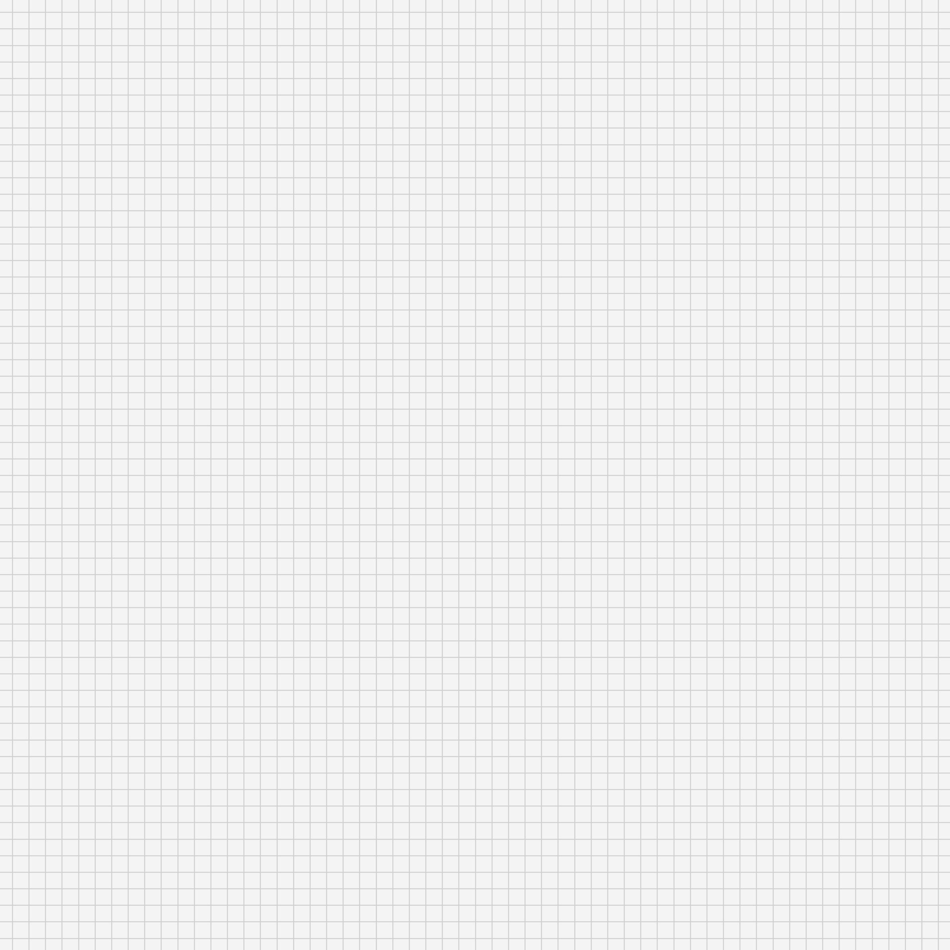
Let’s Get Started with a...
Search
TSA Meeting!
Feb. 13 2025

Slide 2
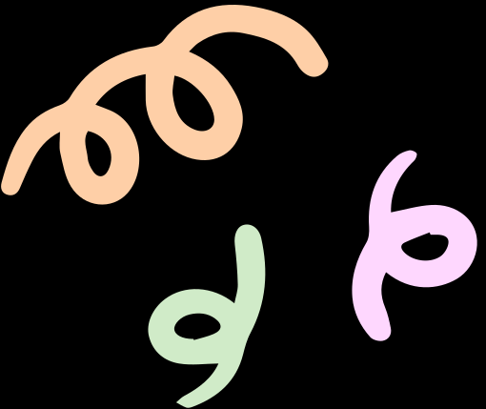


Awesome Work!
Shout Out to all of our Cyber Patriot Teams
Great Job ^_^

Slide 3
TSA State Competition
Save the date!

Slide 4


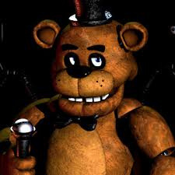



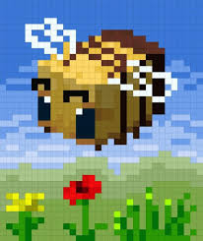
Events
Coding
Animatronics
Forensic Science
Photography
Childrens Stories
Video Game Design

Slide 5


 | When? April 15-17
 | Cost: $250
 | Competing in various events!
 | Deadline to Register Feb. 18th
General Info
Ik We are all very excited

Slide 6
Nationals
Coming Up in the Not So Distant Future

Slide 7

Thank you!
Until our next petty debate!

